Slide 1

Databases & SQL for Analysts: Final Project Presentation
Vijayaraghavan Kasturi
21-November-2024

Slide 2
Topics
Setting the Context
Key Questions & Objectives
Presenting the Findings
Recommended Actions

Slide 3
Setting the Context
Rockbuster Stealth LLC is a movie rental company that used to have stores around the world. Facing stiff competition from streaming services such as Netflix and Amazon Prime, the Rockbuster Stealth management team is planning to use its existing movie licenses to launch an online video rental service to stay competitive.
I’ve been hired as a data analyst by Rockbuster Stealth’s business intelligence (BI) department to help with the launch strategy for the new online video service.
The following slides will walk us through the key business questions, what the data analysis tells us, and what the recommended course of action should be.

Slide 4
Key Questions & Objectives
Do sales figures vary between geographic regions?
Which countries are Rockbuster customers based in?
Where are customers with a high lifetime value based?
What was the average rental duration for all videos?
Which movies contributed the most / least to revenue gain?

Slide 5






Key Business Indicators
1000
English Movies
5
Days Avg. Rental
599 Customers
108
Countries
17
Genres
2.98
Avg. Rental Revenue

Slide 6
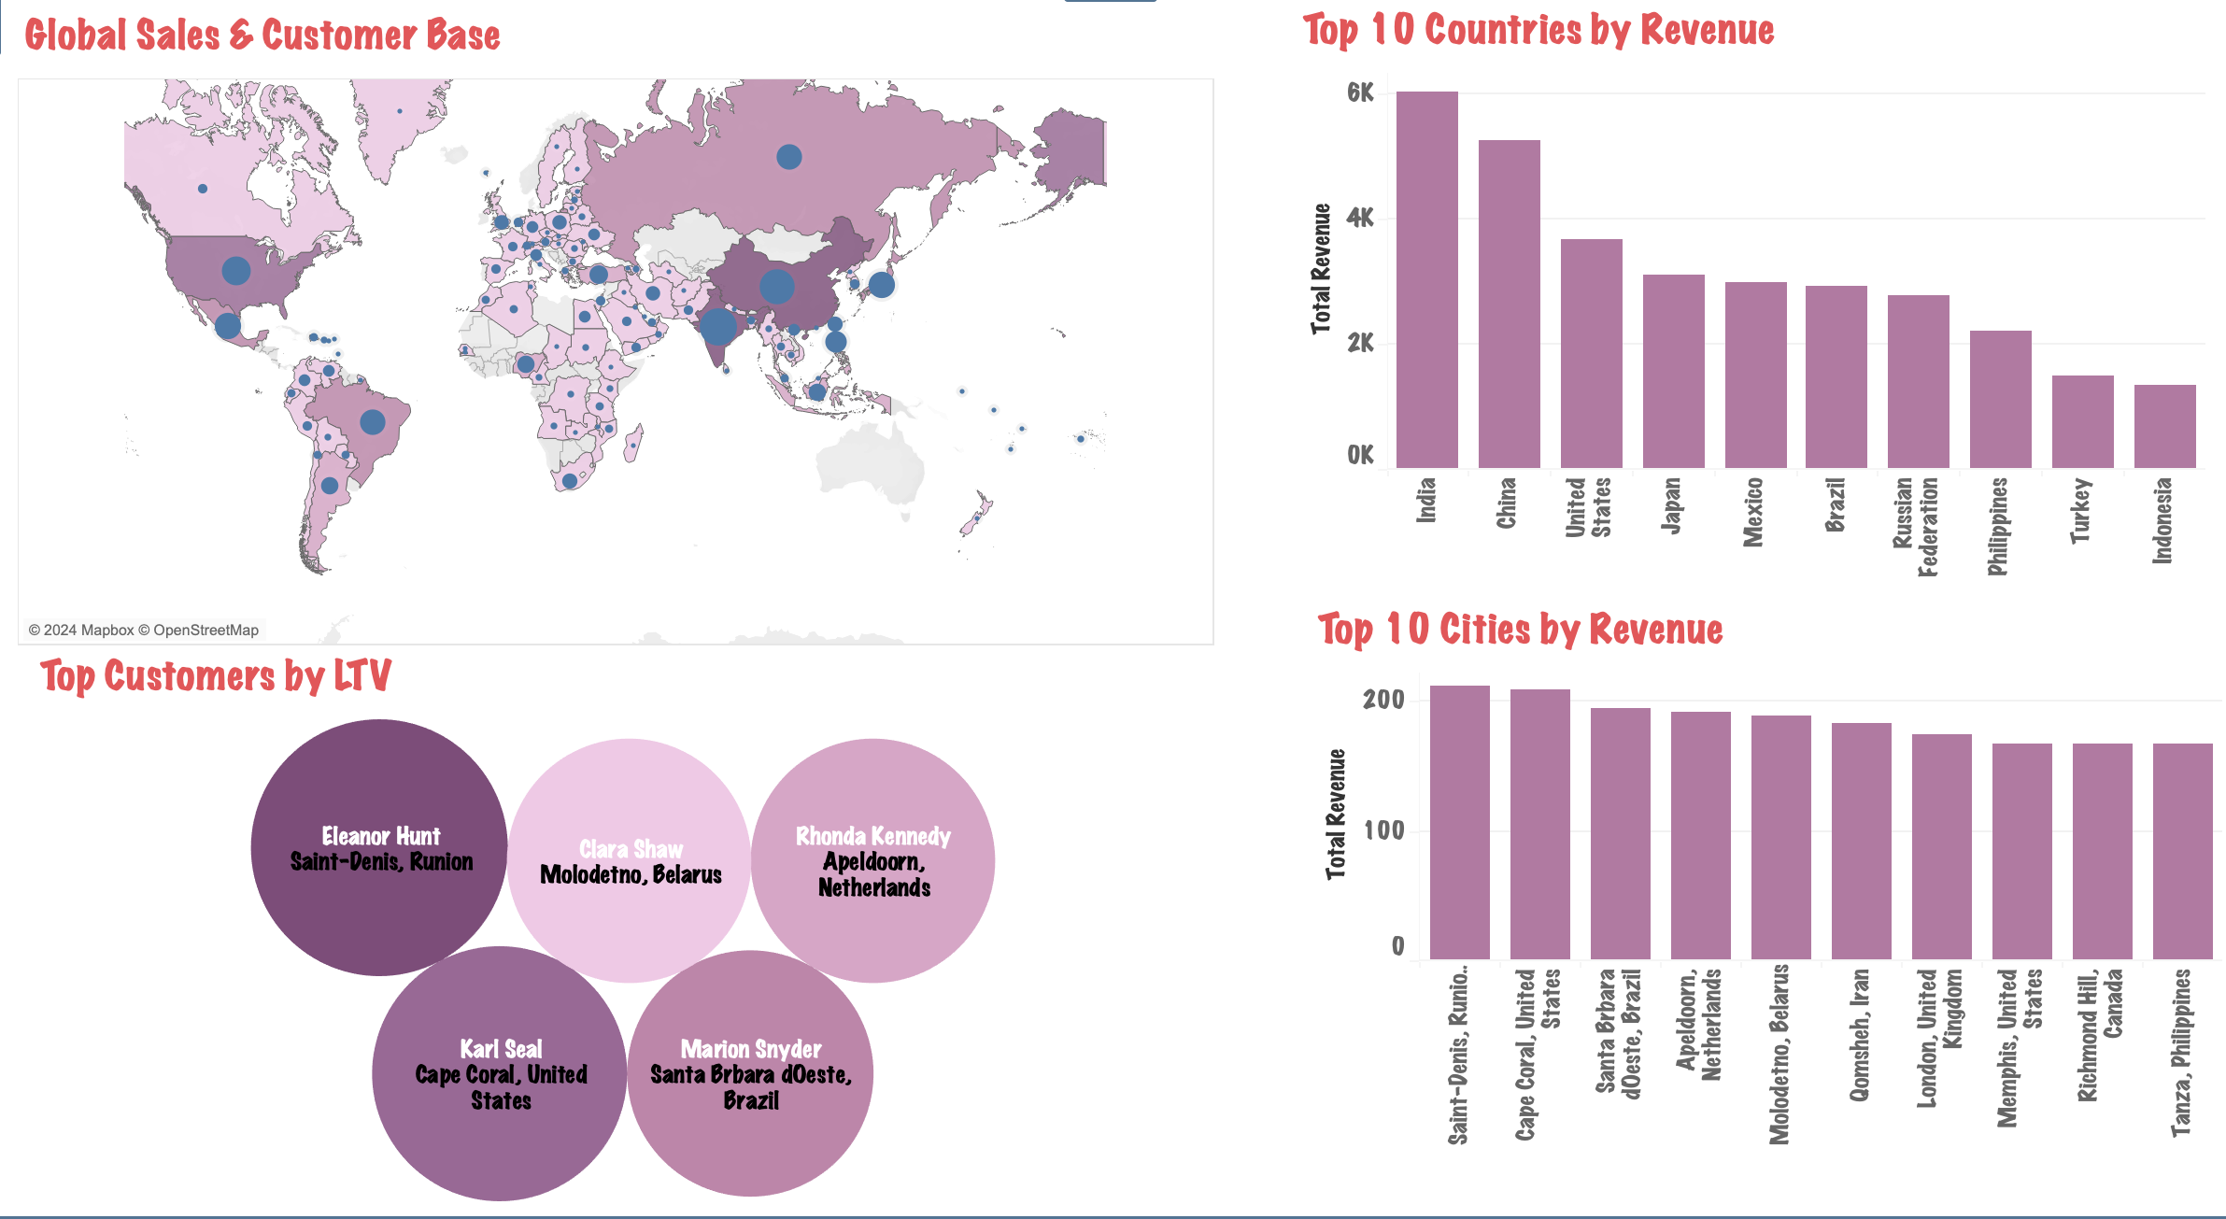
Sales Snapshot

Slide 7
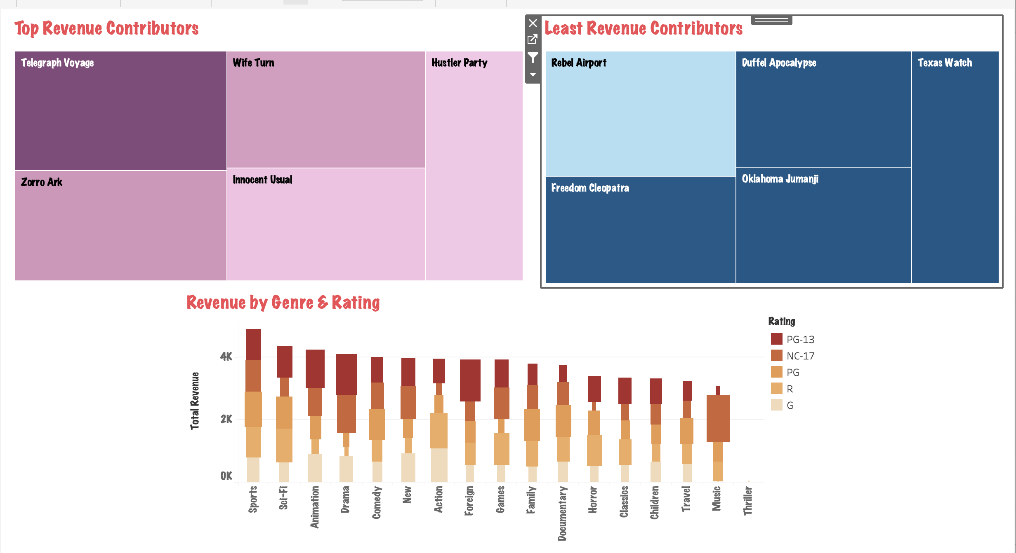
Top (& Bottom) Grossers

Slide 8
What these Findings tell us
ASIA is the biggest region by revenue – India, China & Japan in Top 5 countries, followed by NORTH AMERICA (2 out of 5).
Telegraph Voyage is the Top Grossing Movie, while Texas Watch contributes the least
Movies in the Sports Genre generate most revenue among the 17 on offer.
Movies with PG-13 rating outperform the others.

Slide 9
Recommendations
Increase the marketing budget for Asia & North America to attract more customers.
Promote movies from popular genres to increase average revenue.
Remove the bottom 5-10% of titles to save on license fees.
Introduce Loyalty Bonus for customers with high Lifetime Value and to promote more spend among existing customer base.

Slide 10
Tableau Sheets & Dashboards
https://public.tableau.com/authoring/3_10_RockbusterVisualizations/Revenue-Customer#1

Slide 11
Thank You
Email: Vijayaraghavan.x.Kasturi@gmail.com
Mob: +49 172 168 6096

